Slide 1


Slide 2


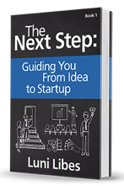




Pitching

Slide 3
Keep in mind…
Every pitch can be improved
  Embrace all the feedback this week
  All the feedback is altruistic
  Enough feedback = contradictory

Slide 4
Know the Audience
Why are there there?
What do they want?
What else will they be watching?
  Who is your real competition?

Slide 5
Put yourself in their shoes…

Slide 6


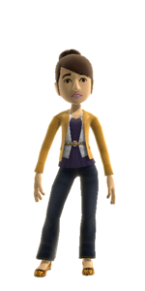
Imagine a Pitch…

Slide 7
Is There a There There?
Does it “feel” like a viable business?
  Do you feel like investing / buying / joining?
  (pick any two)

Slide 8
Did you think?
Did you stop and think?
  Did the opening leave you wondering?
  Did the pitch take you on a journey?
  Audience thinking = A poor pitch

Slide 9
Do you have any questions?
All topic covered?
  Path to revenues?
  Opportunity understood?
  Competition analyzed?
  An “Ask?”
Investor Pitch
Title Problem Solution Customers & Market Opportunity size Competition Uniqueness Team Financial Overview Amount and planned use of funding Q&A Next steps Thank you [Appendix]

Slide 10
Bears or Goldilocks?
Was there too much material,
too little, or was it just right?
  Too many words
    On-screen
    Verbal
  Too fast? Too slow?

Slide 11
Who read the slides?
Did the presenter(s) just read the slides?
  Especially the lists
    Reading slides is bad
    We can read slides for ourselves
    We don’t need them read to us
    Nor do we need
    Lists that have
    More than 3-5 entries
    Less is more

Slide 12
Q&A?
Did the Q&A seem prepared?
  The pitch ends AFTER the Q&A
  Appendix slides for all expected questions
  One answer by one presenter

Slide 13
Did the end end?
Did the presenter(s) close or walk off?
  Own the room until you leave (the stage)
  Or did the presentation just fizzle out?

Slide 14
An example pitch…

Slide 15
Concrete Battery
Overview
January 2013

Slide 16
Problem
Wind and solar produce power intermittently
Power consumers want steady, reliable power 24x7x365
Storing industry-scale power is
not cost effective

Slide 17
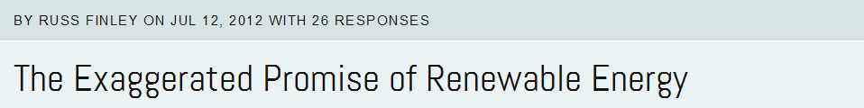

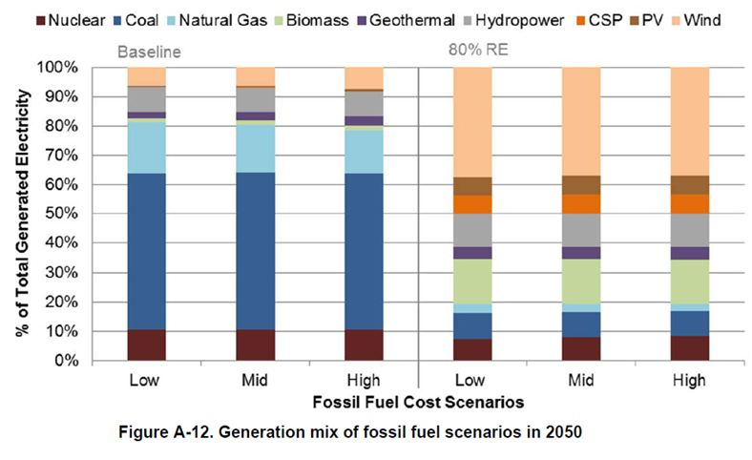
Notes:
http://www.flickr.com/photos/neilmoralee/9135773464

Slide 18
Solution
Low cost
Minimal technology
Flywheel energy storage
E = MASS x diameter² x RPM²

Slide 19
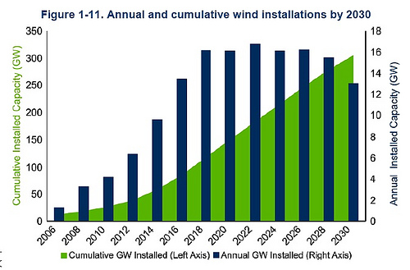

Opportunity Size

Slide 20
Go-to-Market
Sales of flywheels to
  Wind/Solar Manufacturers
  Electricity Utilities (power generation)
  Industrial customers (backup power)

Slide 21
Revenue Projections
$50M
$40M
 | 2016 | 2017 | 2018 | 2019 | 2020
# customers | 1 | 3 | 10 | 30 | 100
# flywheels | 3 | 10 | 50 | 200 | 500
$ revenues | $0.3M | $1M | $5M | $20M | $50M
$30M
$20M
$10M
$0
2016
2017
2018
2019
2020

Slide 22
Competition
 | Concrete Flywheel | Active Power | Pentadyne | Beacon | R&D Solutions
Kinetic-based storage | ✓ | ✓ | ✓ | ✓
“Instant” input & output | ✓ | ✓ | ✓ | ✓ | ✓
Industrial-scale | ✓ | ✓ | ✓ | ✓ | ✓
Low-tech (low cost) | ✓ |  |  |  | ✓
High-tech (high cost) |  | ✓ | ✓ | ✓
Government loans |  |  |  | ✓

Slide 23
Competitive Advantage
Lowest-cost solution
  “Keep it simple” design philosophy
  Lowest-possible technologies
Ubiquitous deployment
  Any terrain, any geography, anywhere

Slide 24
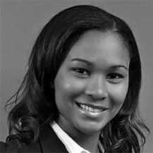
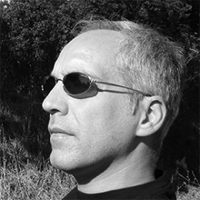


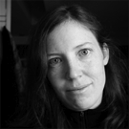
The Team
Joan Jones, CEO
Co-founder XYZ Corp
Bob Green, VP Sales
Co-founder XYZ Corp
Joe Smith, CTO
Pacific Electric
Dr. Joe White
Renewable21 Association
Lisa Brown
U.S. Department of Energy

Slide 25
Funding
$5 million
$2 million committed
Use of funds:
  1 Paid Customer
  5 Deployed Prototypes
  R&D to reduce production costs by 25%

Slide 26
Concrete Battery
Thank You
Michael Libes
mlibes@concretebattery.com
206-555-1212

Slide 27
Let’s make this better…

Slide 28
Concrete Battery
Overview
January 2013

Slide 29
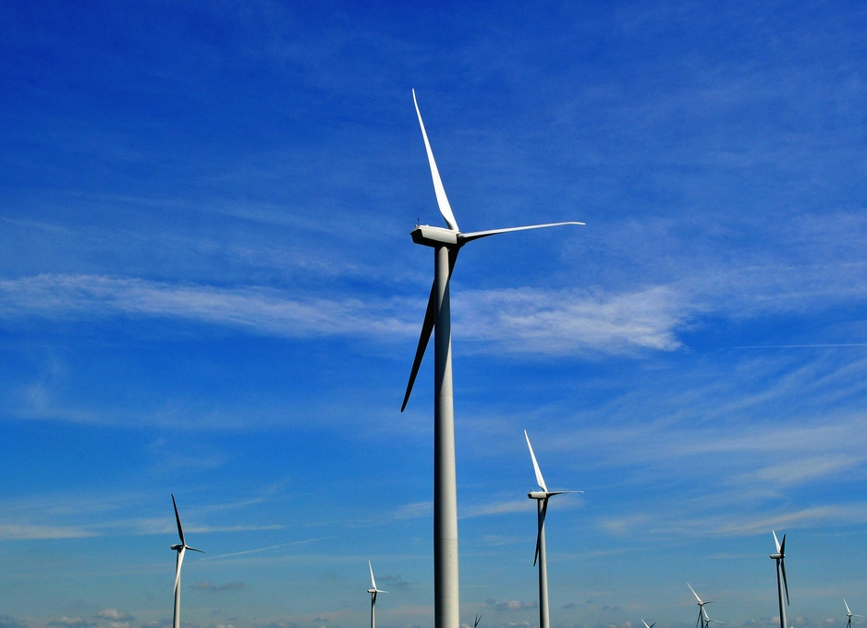
Jill’s Problem
Renewable vs.
24x7x365 power

Slide 30
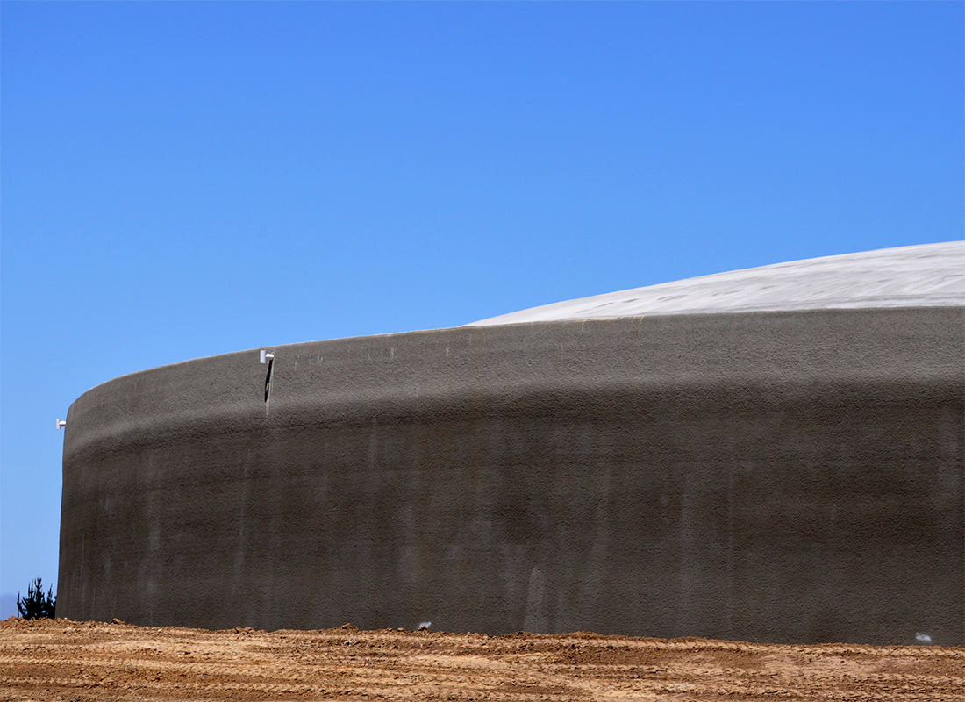
Our Solution
Simple, Low-cost, Minimal-tech

Slide 31
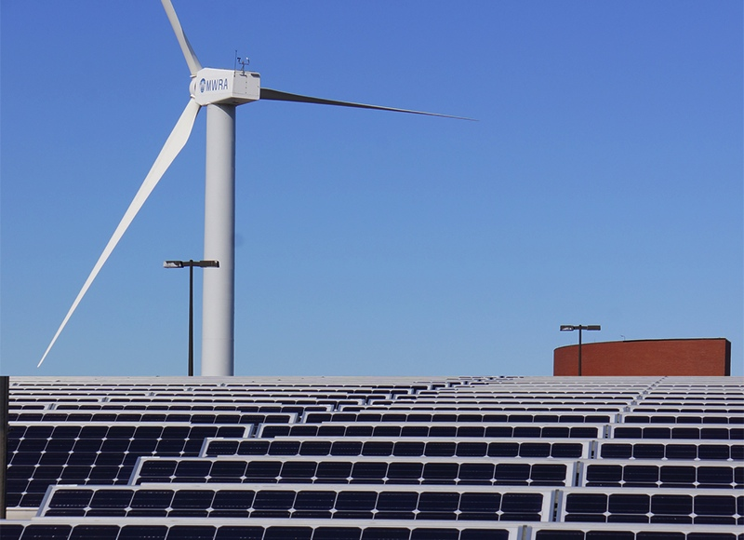
Go-to-Market
Wind/Solar Manufacturers
Electricity Utilities
(power generation)
Industrial customers
(backup power)

Slide 32
Revenue Projections
$50M
$40M
 | 2016 | 2017 | 2018 | 2019 | 2020
# customers | 1 | 3 | 10 | 30 | 100
# flywheels | 3 | 10 | 50 | 200 | 500
$ revenues | $0.3M | $1M | $5M | $20M | $50M
$30M
$20M
$10M
$0
2016
2017
2018
2019
2020

Slide 33
Competition
 | Concrete Flywheel | Active Power | Pentadyne | Beacon | R&D Solutions
Kinetic-based storage
“Instant” input & output
Industrial-scale
Low-tech (low cost)
High-tech (high cost)
Government loans

Slide 34
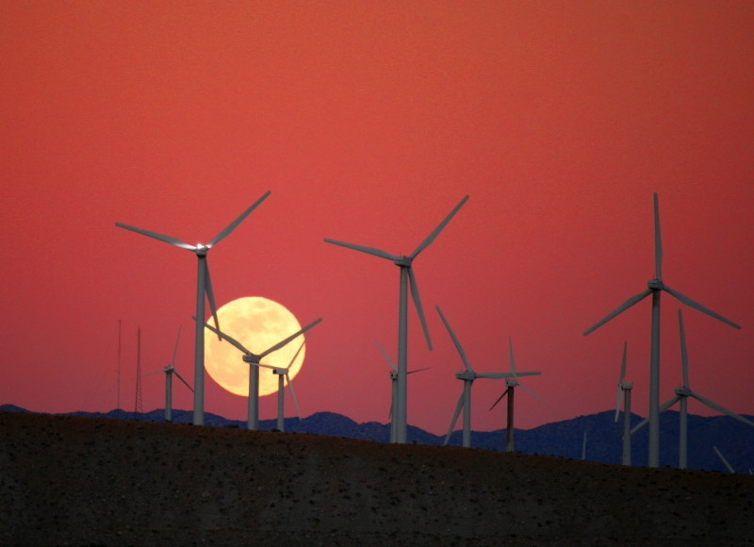
Competitive Advantage
Simple
Ubiquitous
Cost-effective

Slide 35
The Team
Joan Jones, CEO
Co-founder XYZ Corp
Bob Green, VP Sales
Co-founder XYZ Corp
Joe Smith, CTO
Pacific Electric
Dr. Joe White
Renewable21 Association
Lisa Brown
U.S. Department of Energy

Slide 36
Funding
$5 million
$2 million committed
Use of funds:
  1 Paid Customer
  5 Deployed Prototypes
  R&D to reduce production costs by 25%

Slide 37
Concrete Battery
Thank You
Michael Libes
mlibes@concretebattery.com
206-555-1212

Slide 38
Keep iterating…

Slide 39
Concrete Battery
Overview
January 2013

Slide 40
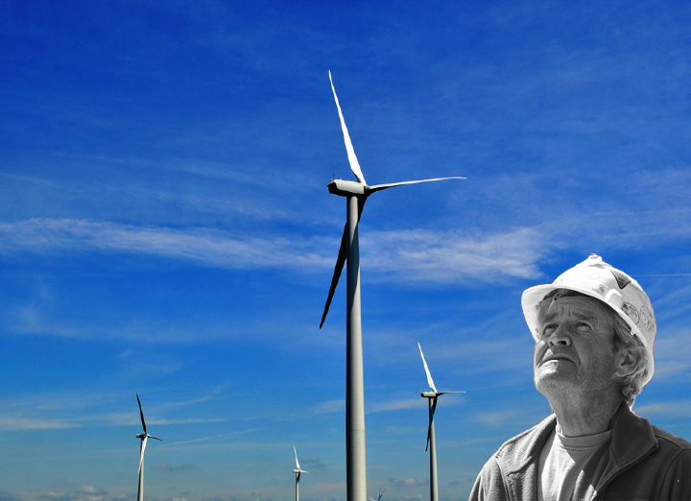
Chuck’s Problem
Renewable vs.
24x7x365 power

Slide 41
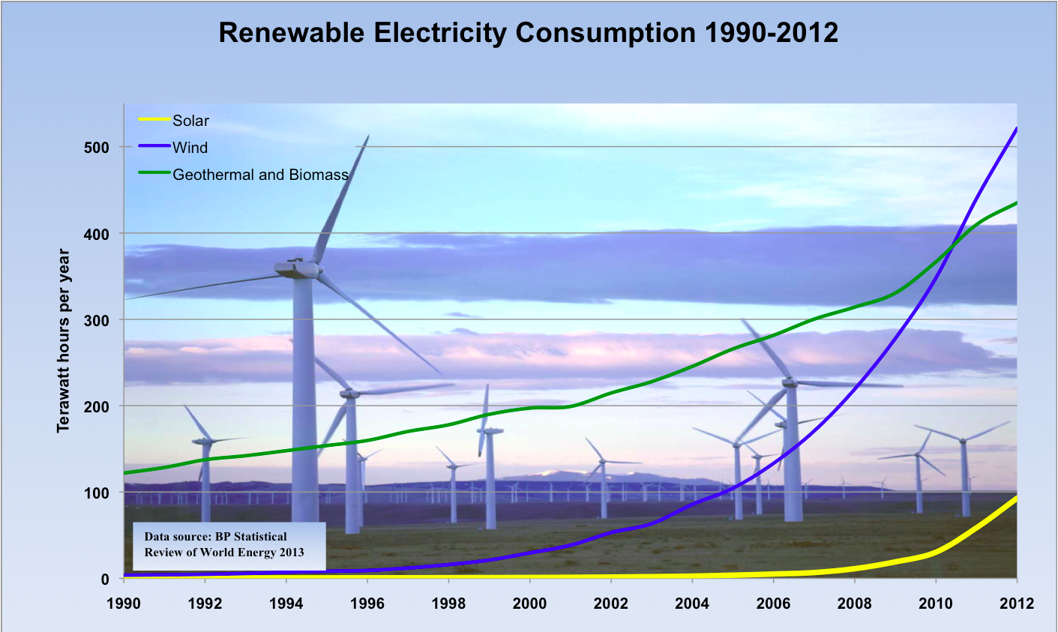


Slide 42
Our Solution
Simple, Low-cost, Minimal-tech

Slide 43
Go-to-Market
Electricity Utilities
(power generation)
Wind/Solar Manufacturers
(24/7/365 power)

Slide 44
Revenue Projections
$50M
$40M
 | 2016 | 2017 | 2018 | 2019 | 2020
# customers | 1 | 3 | 10 | 30 | 100
# flywheels | 3 | 10 | 50 | 200 | 500
$ revenues | $0.3M | $1M | $5M | $20M | $50M
$30M
$20M
$10M
$0
2016
2017
2018
2019
2020

Slide 45
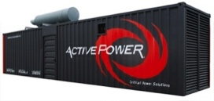


Competition
Concrete
Battery
Low-cost
Pumped Water
Pb Batteries
Low-tech
High-tech
Compressed Air
Li-Ion Batteries
High-cost

Slide 46
Competitive Advantage
Simple
Ubiquitous
Cost-effective

Slide 47
The Team
Joan Jones, CEO
Co-founder XYZ Corp
Bob Green, VP Sales
Co-founder XYZ Corp
Joe Smith, CTO
Pacific Electric
Dr. Joe White
Renewable21 Association
Lisa Brown
U.S. Department of Energy

Slide 48
Funding
$5 million
$2 million committed
Use of funds:
  1 Paid Customer
  5 Deployed Prototypes
  R&D to reduce production costs by 25%

Slide 49
Concrete Battery
Thank You
Michael Libes
mlibes@concretebattery.com
206-555-1212

Slide 50
Good, but still not great…

Slide 51
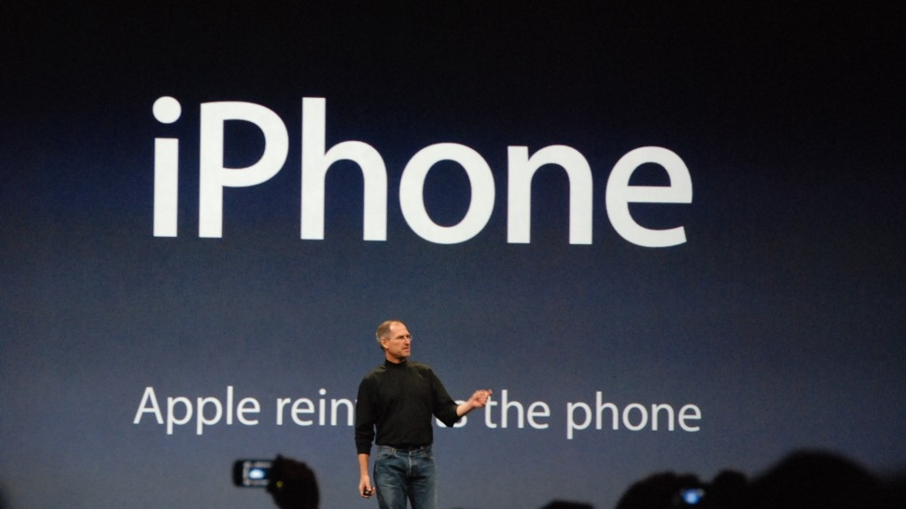

Slide 52
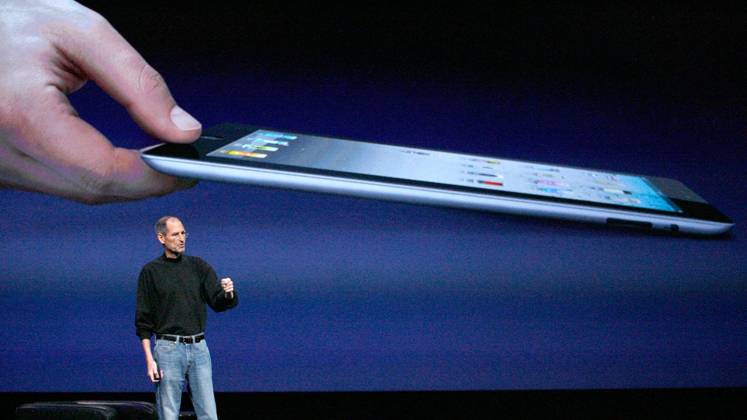

Slide 53
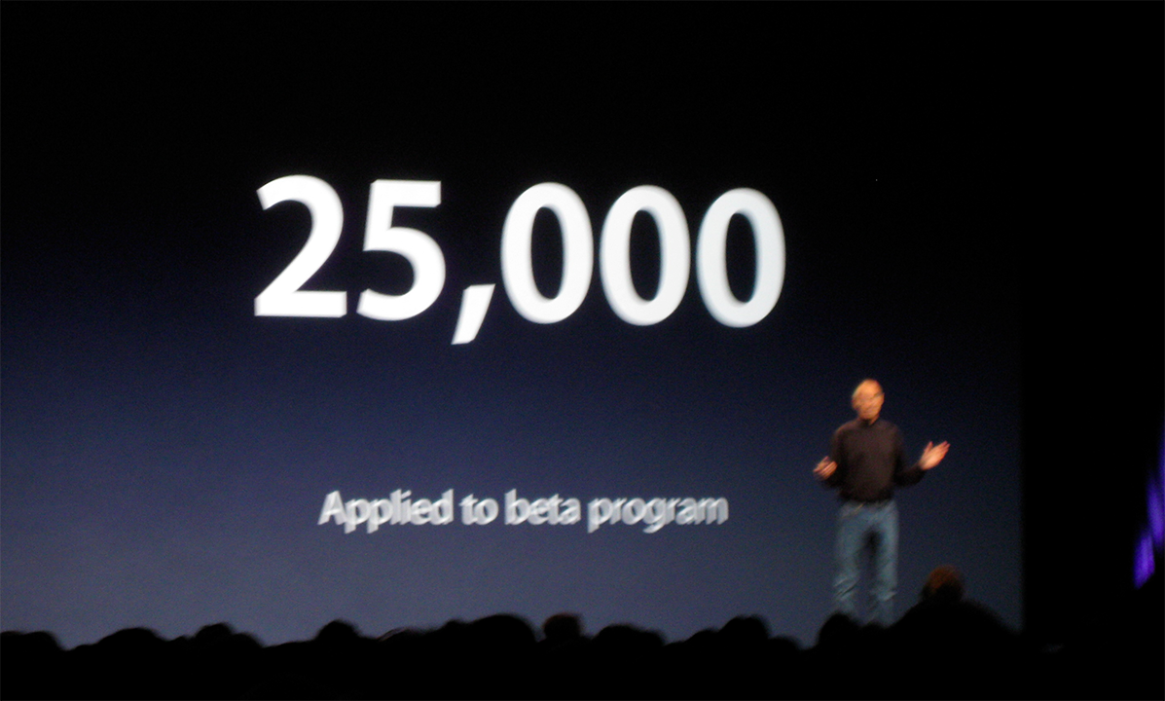

Slide 54
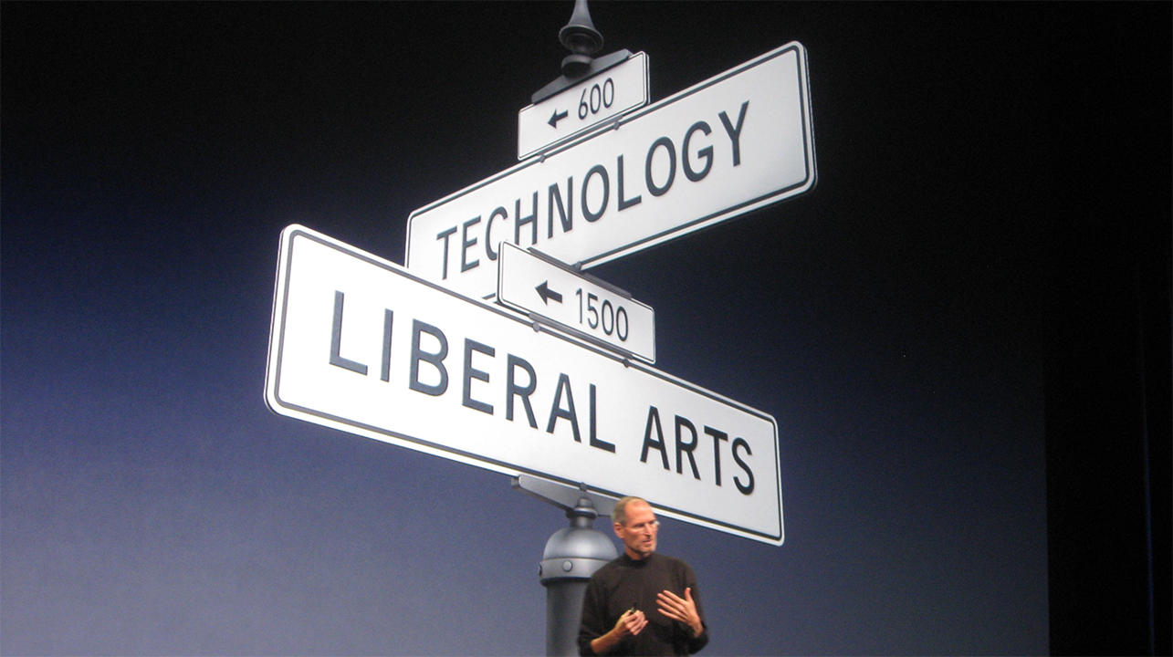

Slide 55
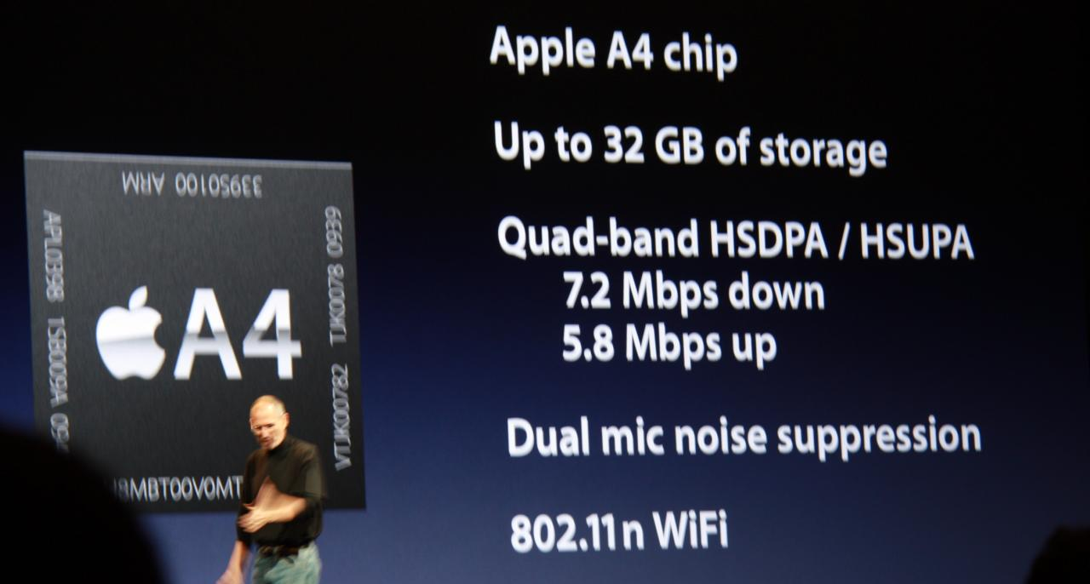

Slide 56
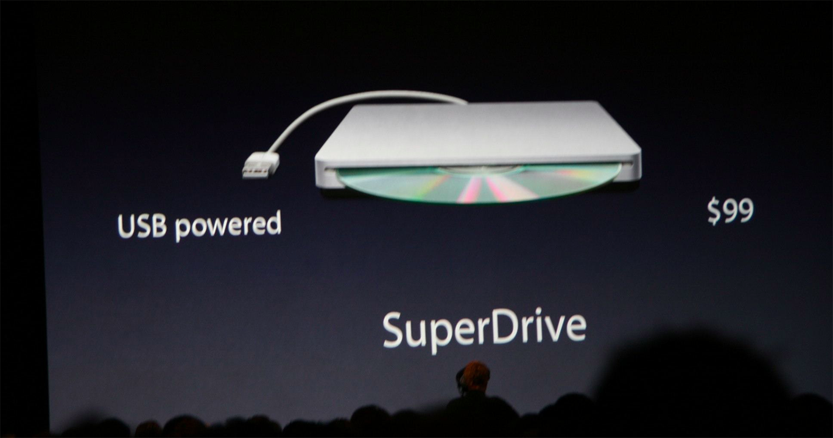

Slide 57
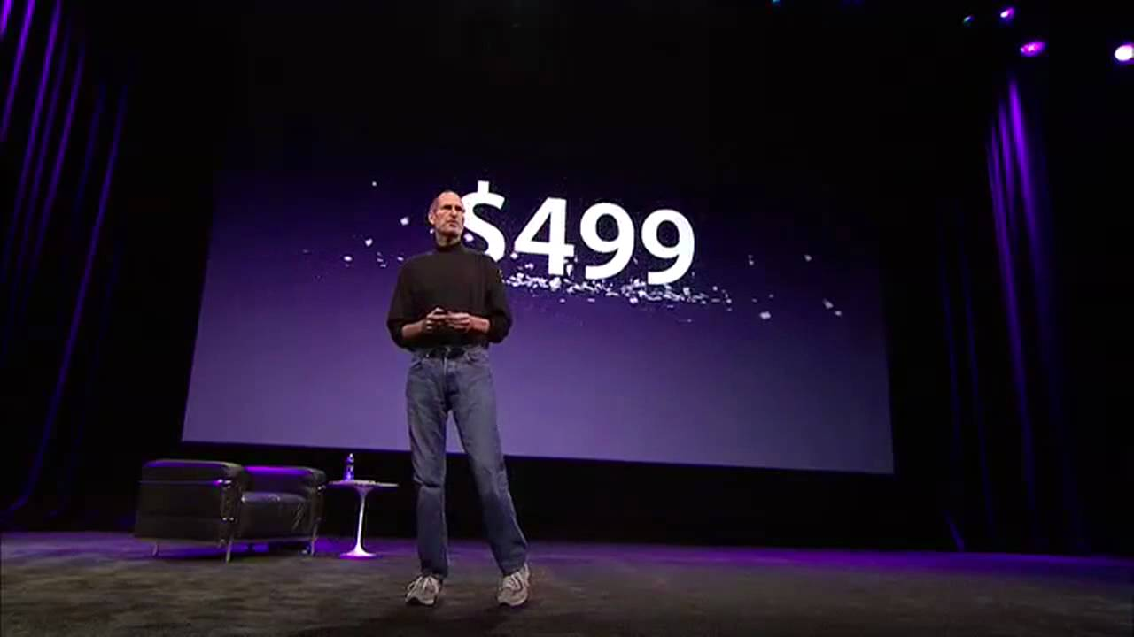

Slide 58
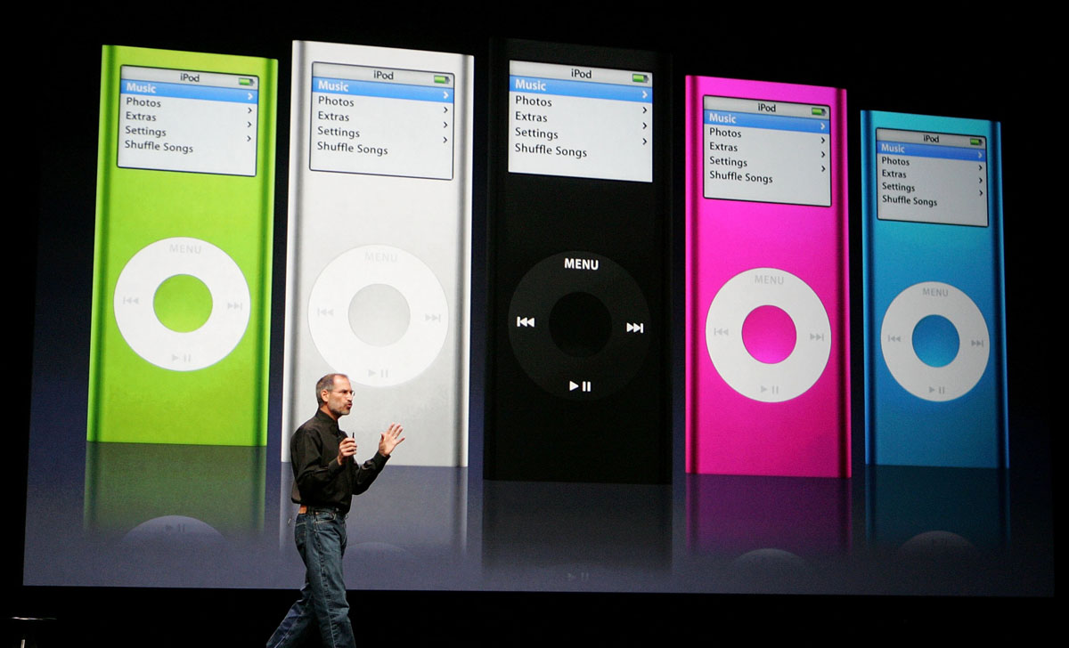

Slide 59
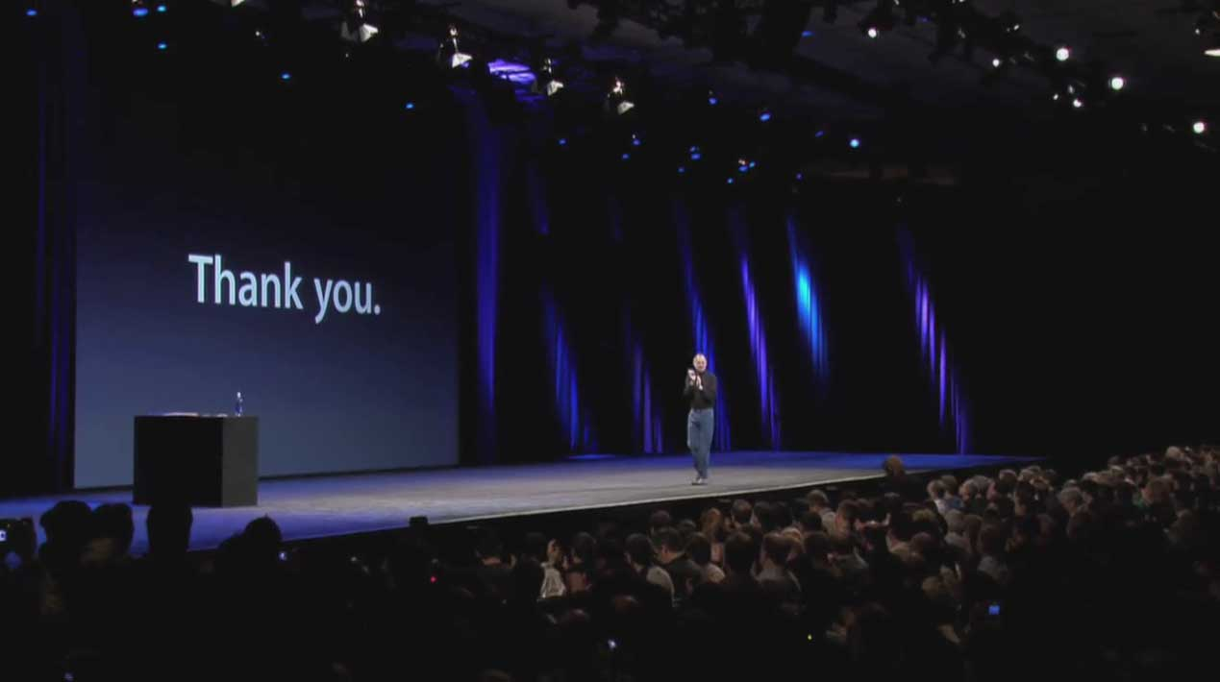

Slide 60
Simple
Terse
Practiced

Slide 61
Ask yourself
How would Pixar tell your story?

Slide 62


Slide 63


Slide 64


Slide 65
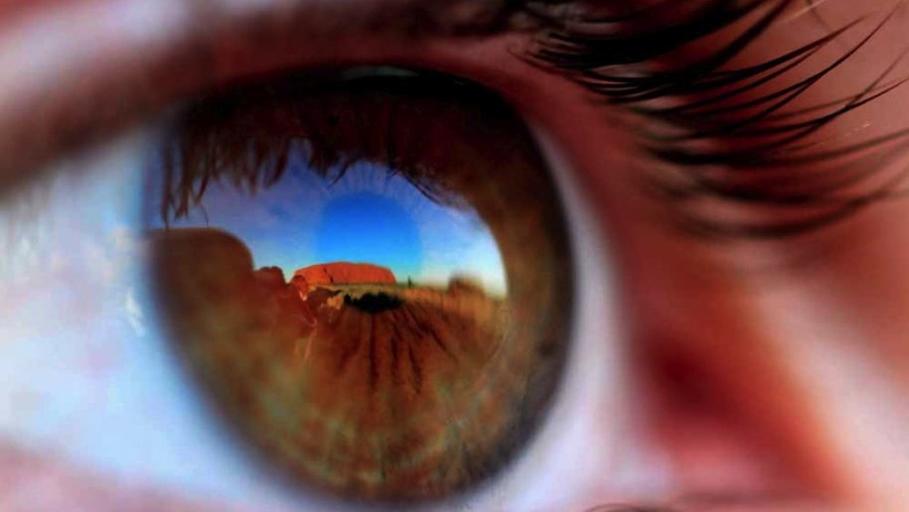
Be Remarkable

Slide 66


Slide 67
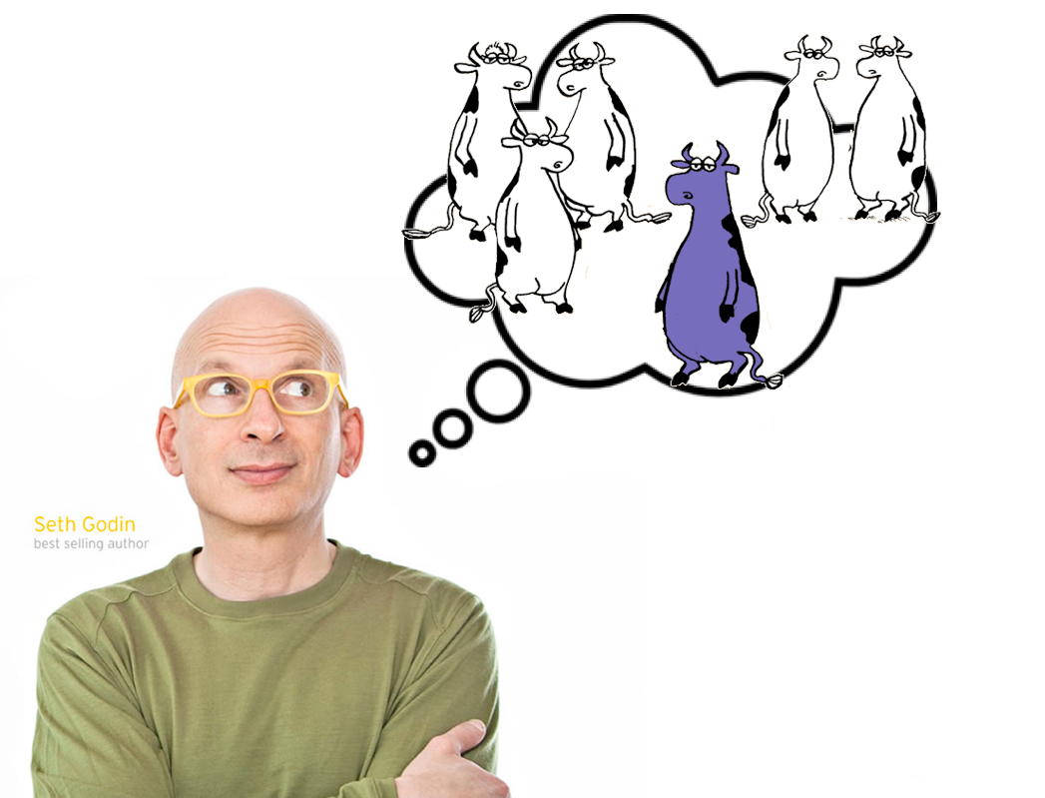

Slide 68
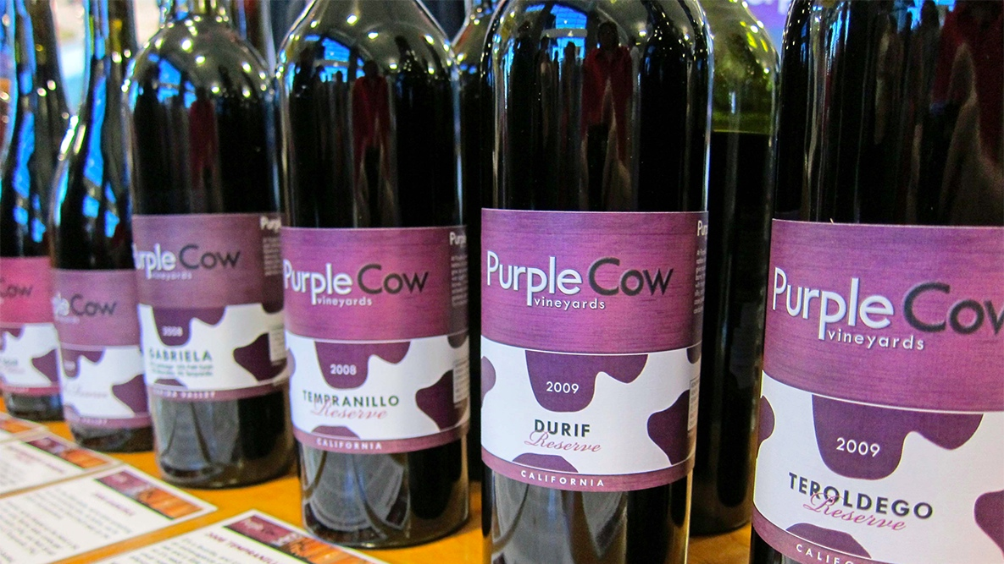

Slide 69


Slide 70


Slide 71
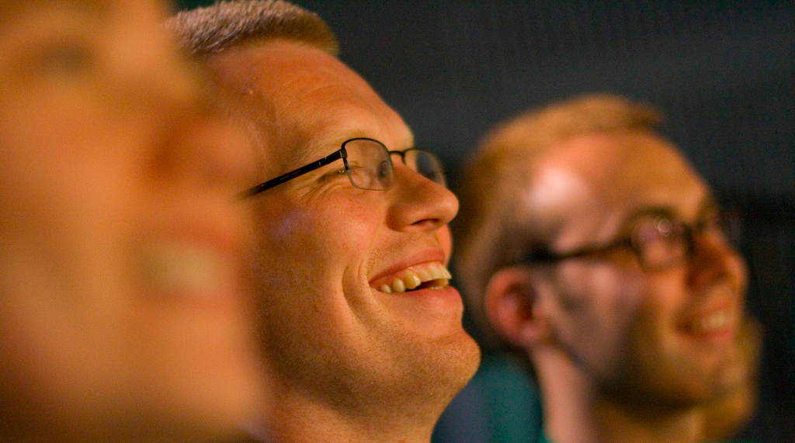

Slide 72
And finally, remember…

Slide 73
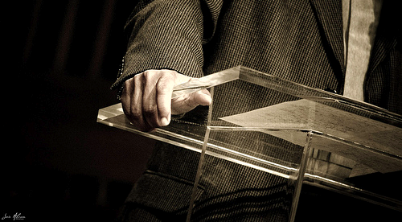
Own the Room

Slide 74
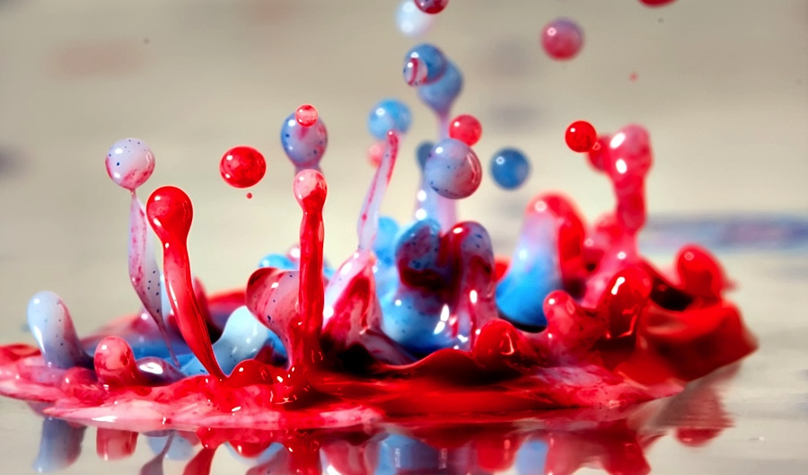
Be Excited

Slide 75
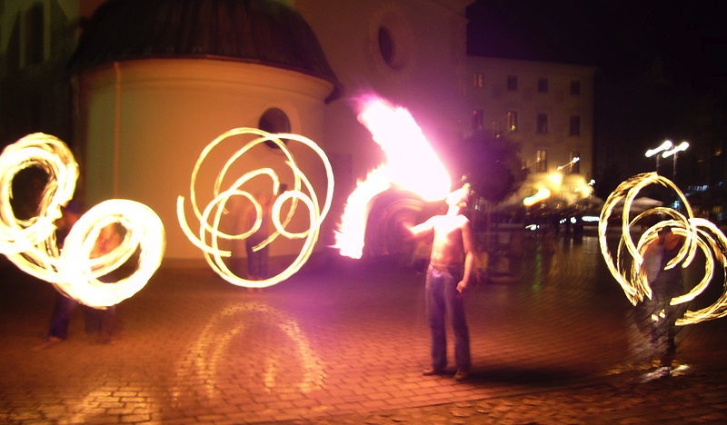
Entertain

Slide 76
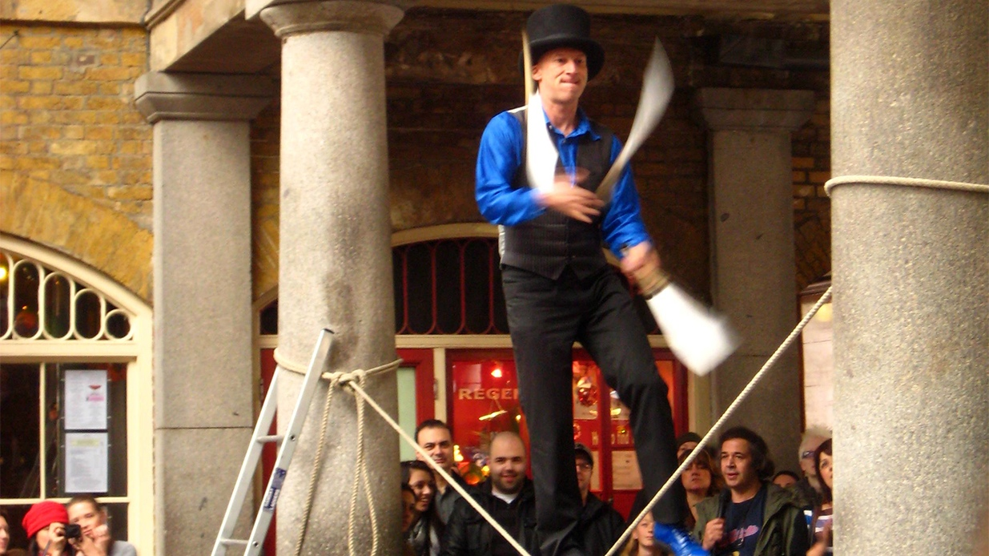
Practice…

Slide 77
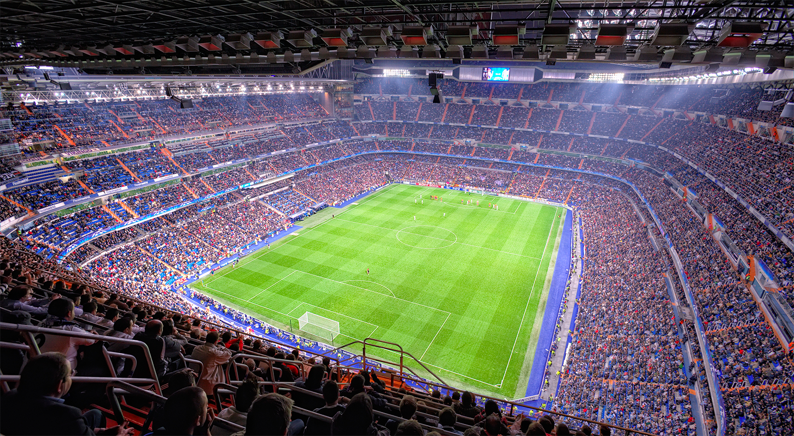
Practice…

Slide 78
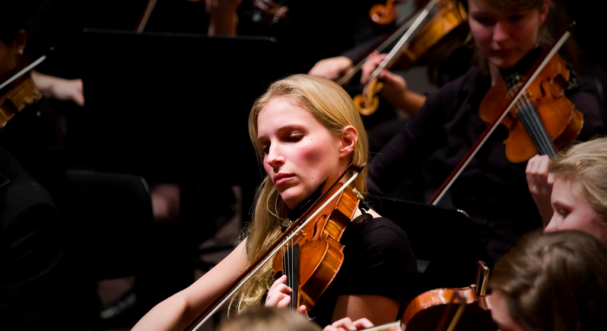
Practice!

Slide 79
Pitching

