Slide 2
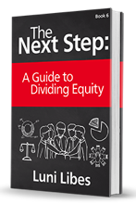

Slide 3
Define “Entrepreneur”
What are the qualities of an entrepreneur?

Slide 4
Define “Entrepreneur”
Passionate
Persistent
Resourceful

Slide 5
Persistent
Phone isn’t ringing. What do you do?
Potential buyer says “no”. Next steps?
No funding. How do you move forward?

Slide 6
Resourceful
Entrepreneurs look not at their limited resources and ask “what is possible”, they say what is possible and find the resources to make it possible

Slide 7
“Relentlessly Resourceful”
Planning without regard to one’s limited resources

